Slide 1
Day 3 (MM/DD/YYYY)
D-Code

Slide 2
Welcome!

Slide 3
Standup
HTML Semantics
Iterative Development
Images
Input and Buttons
Page Navigation

Slide 4
try{whatDoYouRemember();}
Notes:
-What does HTML stand for?
-What is it used for?
-What is an element?
-What is a tag?
-What does this mean: <h1>?
-What would it look like if the 1 were a 3?

Slide 5
break;
How do you open an HTML file to edit the code?

Slide 6
continue;
You can open an HTML file to edit by either:
Right clicking on the file -> Open With -> text editor you use.
Opening the text editor you use and selecting File -> Open -> .html file.

Slide 7
Tomato Tomato

Slide 8
Semantic Tags
Elements with a meaning
Describes it’s meaning to the browser and developer
Useful for text-to-speech
Makes types, hierarchies and relationships clearer
HTML5 has new semantic tags that eliminate the need for previous semantic tags.
Notes:
Have students open HelloWorldHTML.html in Atom

Slide 9
<em></em>
Phrase tag
Renders on the browser as italicized text
Use CSS to add additional effects
<em>Software Development is a craft that must one must work to develop</em>

Slide 10
while(writingCode);
SAVE YOUR PROGRESS!!!
File > Save
or
Ctrl + S
Notes:
Lessons Carried Over:
Have students open the html file in their browser to see their changes

Slide 11
Iterative Development
Why?
Because waiting until we’re done writing all our code until we find bugs causes delays in deployment.
How?
Get into the habit of iterating through three steps as you’re developing:
Write some code
Test your code
Fix any bugs
There are other software development methodologies that development teams use but most have this short iterative process in some fashion in common.
Notes:
We’re going to go through the next steps together and develop a site.

Slide 12
<strong></strong>
Phrase tag
Renders on browsers as bold text
Use CSS to add additional effects
<strong>Developers develop software that develops their skillsets</strong>
Notes:
Save Changes then See Changes (refresh browser)

Slide 13
<blockquote></blockquote>
Specifies section quoted
Usually renders on browsers as indented text
In HTML4.01 defines a long quote
In HTML5 defines a quote from another source
<blockquote> With attributes like elegant, creative, long-termed, and seeing the forest and the trees, our results indicate that good software engineering requires engineers to make complex, experienced-driven, contextual considerations. </blockquote>
Notes:
Save Changes then See Changes (refresh browser)

Slide 14
<cite></cite>
HTML 4.01 defines this as a citation
HTML5 defines this as the title of the quote/work
Renders on browsers as italicized
Can be added to the head tag of a blockquote but it won’t be visible on the page
<cite>https://faculty.washington.edu/ajko/papers/Li2015GreatEngineers.pdf</cite>
Notes:
Save Changes then See Changes (refresh browser)

Slide 15
<q></q>
Defines a short quotation
Renders on browsers as quotations
IE does not render this
<q> What Makes A Great Software Engineer?</q>
Notes:
Save Changes then See Changes (refresh browser)

Slide 16
<abbr></abbr>
Defines an abbreviation
Renders on browsers as the abbreviation
Full title display on mouse over
Needs a title attribute
<abbr title="Developer Life">DL</abbr>
Notes:
Save Changes then See Changes (refresh browser)

Slide 17
<dfn></dfn>
Defines a definition
Renders on browsers as italicized
Parent tag of the <dfn> must also contain the definition inside it
There are multiple ways to use the <dfn> tag
<p><dfn>Developer</dfn> an artist and craftsman of software</p>
Notes:
Save Changes then See Changes (refresh browser)

Slide 18
<address></address>
Defines the contact information of the author/owner
It is not for description of a postal address
Renders on browsers as italicized block
Usually included in the <footer> tag
There are multiple ways to use the <dfn> tag
<footer>
<address>Written By: (your name)
Visit Us at: The World Wide Web
</address>
</footer>
Notes:
Save Changes then See Changes (refresh browser)

Slide 19
<del></del>
Defines text that has been deleted
Renders on browsers as strike through
Used with the <ins> tag
Notes:
Save Changes then See Changes (refresh browser)

Slide 20
<ins></ins>
Defines text that has been inserted
Renders on browsers as underlined
Used with the <del> tag
Notes:
Save Changes then See Changes (refresh browser)

Slide 21
<s></s>
Defines text that is no longer correct, accurate or relevant but should not be deleted
Renders on browsers as strike-through
HTML5 redefined this tag
<p><s>Development takes a lot of math skills</s></p>
<p>Development takes creativity and logic</p>
Notes:
Save Changes then See Changes (refresh browser)

Slide 22
Huddle
HTML Semantics
Iterative Development
Images
Input and Buttons
Page Navigation
Notes:
Check-in:
Any questions?

Slide 23
Picture This

Slide 24
Images
Save images in the size you want
Can define a height and width in the <img> tag
Store images in a folder in the project
<img src=“images/image.gif” alt=“an image”>

Slide 25
<img/>
Defines an image
Empty element, which means it does not have a closing tag.
Requires attributes src and alt
Images are not inserted but linked

Slide 26
src=“”
Source of the image file
Requires a URL value
Absolute URL (ie. http://www.web.com)
Relative URL (ie. images/image.gif)

Slide 27
alt=“”
Defines alternate text for an image
Understandable by search engines and screen reader software
Images with no meaning should use an empty alt text
Title attribute can be used for more description, will be rendered as a tool tip

Slide 28
try{addImage();}
Create a file folder in the helloWorld folder named images
Search the internet for an image
Save the image in the images folder as image.jpg
Add the image to helloWorld.HTML
Notes:
Save Changes then See Changes (refresh browser)

Slide 29
catch{addCaption();}
Add a caption to your image
<figure>
<img src=“images/image.jpg” alt=“image”>
<br>
<figcaption>Caption here</figcaption>
<figure>
Notes:
Save Changes then See Changes (refresh browser)

Slide 30
Huddle
HTML Semantics
Iterative Development
Images
Input and Buttons
Page Navigation
Notes:
Check-in:
Any questions?

Slide 31
Easy Button

Slide 32
<input/>
Empty element
Defines field where user can input data
Can be used within <form> element
Input type varies based on attributes

Slide 33
type=“text”
Defines one line of text input
Renders as a rectangle
Can be used with the name attribute to name the field
Must be used within a <form>

Slide 34
type=“password”
Defines a password field
Renders as a rectangle
Renders text inputted as asterisks or circles
Must be used within a <form>

Slide 35
type=“submit”
Defines button for submitting data to form-handler
Renders as a button with a text value label
If no value is added it renders default value of “submit”
Must be used within a <form>

Slide 36
type=“button”
Defines button
Renders as a button with a text value label
Does not have to be used within a <form>

Slide 37
name=“”
Defines the name of the input element
Used to reference elements in Javascript
Only elements with a name will have values passed when a form is submitted.

Slide 38
<input/> restrictions
You can add restrictions to input elements using restrictions

Slide 39
maxlength=“”
Defines the maximum length of characters that can be entered into an input element

Slide 40
size=“”
Defines the width in characters that can be entered into an input element
If your size is too small the browser will not display all the entered text

Slide 41
<textarea></textarea>
Defines multi-line text input control
Holds unlimited number of characters
Text added to the tags will render inside the box
Renders fixed width font
Use attribute cols to set a value for the visible width
Use attribute rows to set visible number of lines

Slide 42
try{addToHelloWorld();}
Add an <input> to your HelloWorld.HTML file
Add a <textarea> to your HelloWorld.HTML file
Notes:
Save Changes then See Changes (refresh browser)

Slide 43
catch{addMore();}
Add an input type=“radio” to your HelloWorld.HTML
Add an input type=“checkbox” to your HelloWorld.HTML
Note:
Users are only able to select one of the possible options
You can have a preselected radio or checkbox by adding the checked attribute to the input element
Notes:
Save Changes then See Changes (refresh browser)

Slide 44
break;
Can you add an image to a button?

Slide 45
continue;
<button>
<img src=“images/image.jpg” alt=“image” width=“10px” height=“10px”>
Button Text</button>
You don’t have to include an image. Without one, the button will render with the text inside the element. Images render to the left of any text.
Add a button to your HelloWorld.HTML file
Notes:
Save Changes then See Changes (refresh browser)

Slide 46
Huddle
HTML Semantics
Iterative Development
Images
Input and Buttons
Page Navigation
Notes:
Check-in:
Any questions?

Slide 47
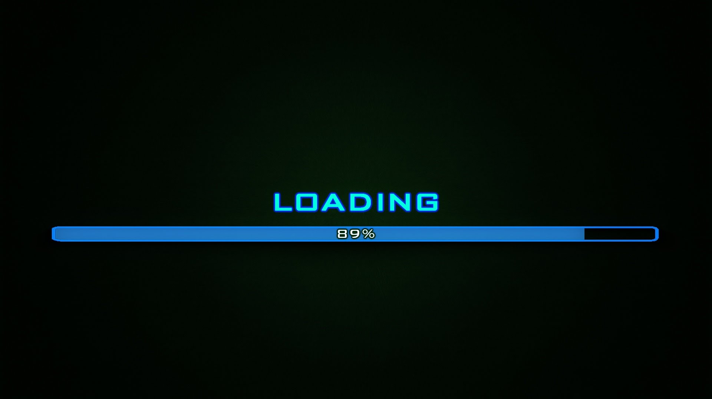
Time Remaining: 5 mins
Notes:
Student break

Slide 48
Paging Dr. Dev

Slide 49
Page Navigation
You can link to another page within the same project by using a Relative URL
The browser starts looking in the folder you are currently inside of
The href value will just be the name of the file if it’s located in the same folder

Slide 50
<a href=“relative url”></a>
Create a new HTML file in the HelloWorld folder
Save file as “HelloAgainHTML.html”
Copy code from HelloWorldHTML and paste it inside HelloAgainHTML
Make some changes
Add a link inside HelloWorldHTML to HelloAgain
Notes:
Save Changes then See Changes (refresh browser)

Slide 51
Directory Structure
You can use links to navigate up and down file structures
../ is up a folder
/ is down a folder

Slide 52
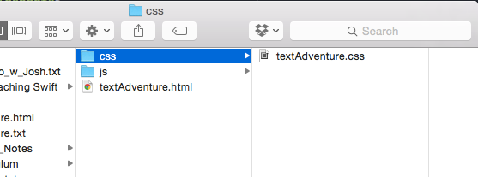
break;
If this is your file structure…
How would you access textAdventure.css from textAdventure.html?

Slide 53
continue;
href=“/textAdventure.css”

Slide 54
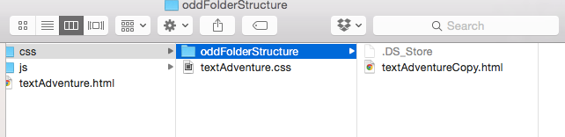
break;
If this is your file structure…
How would you access textAdventure.css from textAdventureCopy.html?

Slide 55
continue;
href=“../textAdventure.css”

Slide 56
Huddle
HTML Semantics
Iterative Development
Images
Input and Buttons
Page Navigation

Slide 57
finally{
talkAboutWhatWe’veLearned();
}
Notes:
Discuss topics covered:
HTML Semantics:
Images:
Input and Buttons:
Page Navigation:
Iterative Development:
Working with less step by step guidance:
-How did you feel about it?
-How many times did you forget to save?
Overall:
-What went well?
-What could have gone better?
-What will we do to improve?

Slide 58
Now We’re Done
HTML Semantics
Iterative Development
Images
Input and Buttons
Page Navigation
At least… by our definition of done.

